Slide 1
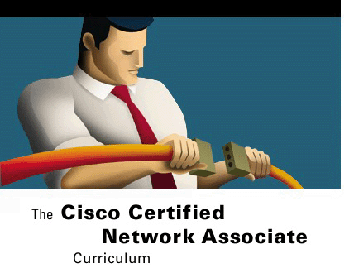
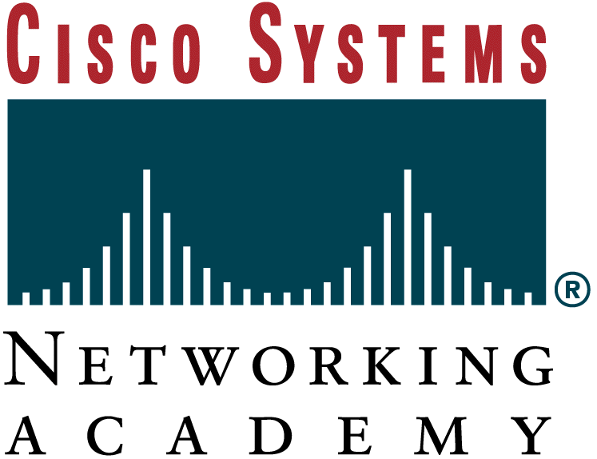


TCP/IP Protocol Suite and
IP Addressing
Networking Basics
Version 3.0
Cisco Regional Networking Academy

Slide 2
Objectives
Explain why the Internet was developed and how TCP/IP fits the design of the Internet.
List the four layers of the TCP/IP model.
Describe the functions of each layer of the TCP/IP model.
Compare the OSI model and the TCP/IP model.
Describe the function and structure of IP addresses.
Understand why subnetting is necessary.
Explain the difference between public and private addressing.
Understand the function of reserved IP addresses.
Explain the use of static and dynamic addressing for a device.
Understand how dynamic addressing can be done using RARP, BootP and DHCP.
Use ARP to obtain the MAC address to send a packet to another device.
Understand the issues related to addressing between networks.
Notes:
The Internet was developed to provide a communication network that could continue to function in wartime. Although the Internet has evolved in ways very different from those imagined by its architects, it is still based on the TCP/IP protocol suite. The design of TCP/IP is ideal for the decentralized and robust network that is the Internet. Many protocols used today were designed using the four-layer TCP/IP model. It is useful to know both the TCP/IP and OSI networking models. Each model offers its own structure for explaining how a network works but there is much overlap between the two. Without an understanding of both, a system administrator may not have sufficient insight into why a network functions the way it does.
Any device on the Internet that wants to communicate with other Internet devices must have a unique identifier. The identifier is known as the IP address because routers use a layer three protocol, the IP protocol, to find the best route to that device. IPv4, the current version of IP, was designed before there was a large demand for addresses. Explosive growth of the Internet has threatened to deplete the supply of IP addresses. Subnetting, Network Address Translation (NAT) and private addressing are used to extend IP addressing without exhausting the supply. Another version of IP known as IPv6 improves on the current version providing a much larger address space, integrating or eliminating the methods used to work with the shortcomings of IPv4.
In addition to the physical MAC address, each computer needs a unique IP address, sometimes called logical address, to be part of the Internet. There are several methods of assigning an IP address to a device. Some devices always have a static address, while others have a temporary address assigned to them every time they connect to the network. When a dynamically assigned IP address is needed, the device can obtain it using several methods.
For efficient routing to occur between devices, other issues must be resolved. For example, duplicate IP addresses can stop efficient routing of data.

Slide 3
Table of Content
1 | Introduction to TCP/IP
2 | Internet addresses
3 | Obtaining an IP addressing
Notes:
Students completing this module should be able to:
Explain why the Internet was developed and how TCP/IP fits the design of the Internet.
List the four layers of the TCP/IP model.
Describe the functions of each layer of the TCP/IP model.
Compare the OSI model and the TCP/IP model.
Describe the function and structure of IP addresses.
Understand why subnetting is necessary.
Explain the difference between public and private addressing.
Understand the function of reserved IP addresses.
Explain the use of static and dynamic addressing for a device.
Understand how dynamic addressing can be done using RARP, BootP and DHCP.
Use ARP to obtain the MAC address to send a packet to another device.
Understand the issues related to addressing between networks.

Slide 4

INTRODUCTION TO TCP/IP

Slide 5
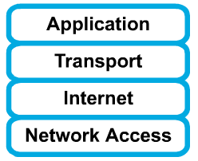
History and future of TCP/IP
Created by the U.S. Department of Defense (DoD)
The TCP/IP model has since become the standard on which the Internet is based.
It is important to note that some of the layers in the TCP/IP model have the same name as layers in the OSI model.
Do not confuse the layers of the two models.
Notes:
The U.S. Department of Defense (DoD) created the TCP/IP reference model because it wanted a network that could survive any conditions. To illustrate further, imagine a world, crossed by multiple cable runs, wires, microwaves, optical fibers, and satellite links. Then imagine a need for data to be transmitted without regard for the condition of any particular node or network. The DoD required reliable data transmission to any destination on the network under any circumstance. The creation of the TCP/IP model helped to solve this difficult design problem. The TCP/IP model has since become the standard on which the Internet is based.
In reading about the layers of the TCP/IP model layers, keep in mind the original intent of the Internet. Remembering the intent will help reduce confusion. The TCP/IP model has four layers: the application layer, transport layer, Internet layer, and the network access layer. Some of the layers in the TCP/IP model have the same name as layers in the OSI model. It is critical not to confuse the layer functions of the two models because the layers include different functions in each model.
The present version of TCP/IP was standardized in September of 1981. As shown in Figure , IPv4 addresses are 32 bits long, written in dotted decimal, and separated by periods. IPv6 addresses are 128 bits long, written in hexadecimal, and separated by colons. Colons separate 16-bit fields. Leading zeros can be omitted in each field as can be seen in the Figure where the field :0003: is written :3:. In 1992 the standardization of a new generation of IP, often called IPng, was supported by the Internet Engineering Task Force (IETF). IPng is now known as IPv6. IPv6 has not gained wide implementation, but it has been released by most vendors of networking equipment and will eventually become the dominant standard.

Slide 6
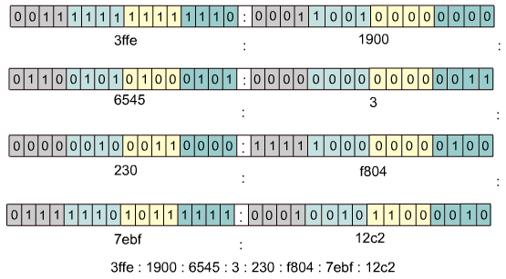
IPv4 and IPv6 (IPng)

Slide 7
Application layer
Responsibility
  Handles high-level protocols, issues of representation, encoding, and dialog control, and assures this data is properly packaged for the next layer.
Concerned
  File Transfer ( TFTP*, FTP*, NFS)
  E-Mail (SMTP)
  Remote Login (Telnet*, rlogin)
  Network management (SNMP*)
  Name Management (DNS*)
    * Used by the Router
Notes:
The application layer of the TCP/IP model handles high-level protocols, issues of representation, encoding, and dialog control. The TCP/IP protocol suite combines all application related issues into one layer and assures this data is properly packaged before passing it on to the next layer. TCP/IP includes not only Internet and transport layer specifications, such as IP and TCP, but also specifications for common applications. TCP/IP has protocols to support file transfer, e-mail, and remote login, in addition to the following applications:
File Transfer Protocol (FTP) – FTP is a reliable, connection-oriented service that uses TCP to transfer files between systems that support FTP. It supports bi-directional binary file and ASCII file transfers.
Trivial File Transfer Protocol (TFTP) – TFTP is a connectionless service that uses the User Datagram Protocol (UDP). TFTP is used on the router to transfer configuration files and Cisco IOS images, and to transfer files between systems that support TFTP. It is useful in some LANs because it operates faster than FTP in a stable environment.
Network File System (NFS) – NFS is a distributed file system protocol suite developed by Sun Microsystems that allows file access to a remote storage device such as a hard disk across a network.
Simple Mail Transfer Protocol (SMTP) – SMTP administers the transmission of e-mail over computer networks. It does not provide support for transmission of data other than plaintext.
Terminal emulation (Telnet) – Telnet provides the capability to remotely access another computer. It enables a user to log in to an Internet host and execute commands. A Telnet client is referred to as a local host. A Telnet server is referred to as a remote host.
Simple Network Management Protocol (SNMP) – SNMP is a protocol that provides a way to monitor and control network devices, and to manage configurations, statistics collection, performance, and security.
Domain Name System (DNS) – DNS is a system used on the Internet for translating names of domains and their publicly advertised network nodes into IP addresses.

Slide 8
Transport Layer
Responsibility
  Provides reliable transport services from the source host to the destination host (end-to-end) over networks.
Concerned
  Segments, data stream, datagram.
  Defines end-to-end connectivity between host applications.
  Transmission control protocol (TCP) – Connection oriented
  User datagram protocol (UDP) – Connectionless
  Flow control provided by sliding windows
  Reliability provided by sequence numbers and acknowledgments
Notes:
The transport layer provides transport services from the source host to the destination host. The transport layer constitutes a logical connection between the endpoints of the network, the sending host and the receiving host. Transport protocols segment and reassemble upper-layer applications into the same data stream between endpoints. The transport layer data stream provides end-to-end transport services.
The Internet is often represented by a cloud. The transport layer sends data packets from the sending source to the receiving destination through the cloud. End-to-end control, provided by sliding windows and reliability in sequencing numbers and acknowledgments, is the primary duty of the transport layer when using TCP. The transport layer also defines end-to-end connectivity between host applications. Transport services include all the following services:

Slide 9
Transport Layer: TCP
TCP supplies a reliably transportation between end-user applications.
These are its characteristics:
  Connection-oriented: Establishing end-to-end operations
  Segmenting upper-layer application data
  Sending segments from one end device to another end device
  Flow control provided by sliding windows
  Reliability provided by sequence numbers and acknowledgments, re-sends anything not received by acknowledgement.
Notes:
TCP and UDP
Segmenting upper-layer application data
Sending segments from one end device to another end device
TCP only
Establishing end-to-end operations
Flow control provided by sliding windows
Reliability provided by sequence numbers and acknowledgments
The Internet is often represented by a cloud. The transport layer sends data packets from the sending source to the receiving destination through the cloud. The cloud deals with issues such as “Which of several paths is best for a given route?”

Slide 10
Transport Layer: UDP
UDP supplies a unreliably transportation between end-user applications.
These are its characteristics:
  Connectionless
  Unreliable: no checking for message delivery.
  No flow control.
  No divides reassembles and messages.

Slide 11
Internet layer
Responsibility
  Select the best path through the network for packets to travel and packet switching
Concerned
  Main protocol that functions at this layer is the Internet Protocol (IP).
  Provides connectionless, best-effort delivery routing of packets
  Defines a packet and an addressing scheme
  Transfers data between the Internet layer and network access layers
  Routes packets to remote hosts
Notes:
The purpose of the Internet layer is to select the best path through the network for packets to travel. The main protocol that functions at this layer is the Internet Protocol (IP). Best path determination and packet switching occur at this layer. The following protocols operate at the TCP/IP Internet layer:
IP provides connectionless, best-effort delivery routing of packets. IP is not concerned with the content of the packets but looks for a path to the destination.
Internet Control Message Protocol (ICMP) provides control and messaging capabilities.
Address Resolution Protocol (ARP) determines the data link layer address, MAC address, for known IP addresses.
Reverse Address Resolution Protocol (RARP) determines IP addresses when the MAC address is known.
IP performs the following operations:
Defines a packet and an addressing scheme
Transfers data between the Internet layer and network access layers
Routes packets to remote hosts
Finally, as a clarification of terminology, IP is sometimes referred to as an unreliable protocol. This does not mean that IP will not accurately deliver data across a network. Calling IP an unreliable protocol simply means that IP does not perform error checking and correction. That function is handled by upper layer protocols from the transport or application layers.

Slide 12
Internet layer (other protocols)
Internet Control Message Protocol (ICMP)
  Provides control and messaging capabilities.
Address Resolution Protocol (ARP)
  Determines the data link layer address, MAC address, for known IP addresses.
Reverse Address Resolution Protocol (RARP)
  Determines IP addresses when the MAC address is known.
Notes:
Internet Control Message Protocol (ICMP) provides control and messaging capabilities.
Address Resolution Protocol (ARP) determines the data link layer address, MAC address, for known IP addresses.
Reverse Address Resolution Protocol (RARP) determines IP addresses when the MAC address is known.

Slide 13
Network access layer
Concerned with all of the issues that an IP packet requires to actually make the physical link. All the details in the OSI physical and data link layers.
Also called the host-to-network layer.
Concerned with all of LAN and WAN technology.
Defines the procedures for interfacing with the network hardware and accessing the transmission medium.
Modem protocol standards such as Serial Line Internet Protocol (SLIP) and Point-to-Point Protocol (PPP) provide network access through a modem connection.
Network access layer functions include mapping IP addresses to physical hardware addresses and encapsulation of IP packets into frames.
Notes:
The network access layer is also called the host-to-network layer. The network access layer is the layer that is concerned with all of the issues that an IP packet requires to actually make a physical link to the network media. It includes the LAN and WAN technology details, and all the details contained in the OSI physical and data-link layers.
Drivers for software applications, modem cards and other devices operate at the network access layer. The network access layer defines the procedures for interfacing with the network hardware and accessing the transmission medium. Modem protocol standards such as Serial Line Internet Protocol (SLIP) and Point-to-Point Protocol (PPP) provide network access through a modem connection. Because of an intricate interplay of hardware, software, and transmission-medium specifications, there are many protocols operating at this layer. This can lead to confusion for users. Most of the recognizable protocols operate at the transport and Internet layers of the TCP/IP model.
Network access layer functions include mapping IP addresses to physical hardware addresses and encapsulation of IP packets into frames. Based upon the hardware type and the network interface, the network access layer will define the connection with the physical network media.
A good example of network access layer configuration would be to set up a Windows system using a third party NIC. Depending on the version of Windows, the NIC would automatically be detected by the operating system and then the proper drivers would be installed. If this were an older version of Windows, the user would have to specify the network card driver. The card manufacturer supplies these drivers on disks or CD-ROMs.

Slide 14
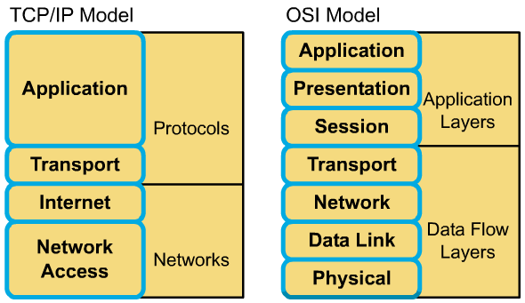
Comparing TCP/IP with OSI

Slide 15
Comparing TCP/IP with OSI (cont.)
Similarities:
  Both have layers.
  Both have application layers, though they include very different services.
  Both have comparable transport and network layers
  Packet-switched technology is assumed.
  Networking professionals need to know both.

Slide 16
Comparing TCP/IP with OSI (cont.)
Differences:
  TCP/IP combines the presentation and session layer issues into its application layer.
  TCP/IP combines the OSI data link and physical layers into one layer.
  TCP/IP appears simpler because it has fewer layers.
  Typically networks aren't built on the OSI protocol, even though the OSI model is used as a guide.

Slide 17

Internet architecture
Notes:
While the Internet is complex, there are some basic ideas in its operation. In this section the basic architecture of the Internet will be examined. The Internet is a deceptively simple idea, that when repeated on a large scale, enables nearly instantaneous worldwide data communications between anyone, anywhere, at any time. LANs are smaller networks limited in geographic area. Many LANs connected together allow the Internet to function. But LANs have limitations in scale. Although there have been technological advances to improve the speed of communications, such as Metro Optical, Gigabit, and 10-Gigabit Ethernet, distance is still a problem.
Focusing on the communication between the source and destination computer and intermediate computers at the application layer is one way to get an overview of the Internet architecture. Placing identical instances of an application on all the computers in the network could ease the delivery of messages across the large network. However, this does not scale well. For new software to function properly, it would require new applications installed on every computer in the network. For new hardware to function properly, it would require modifying the software. Any failure of an intermediate computer or the application of the computer would cause a break in the chain of the messages that are passed.
The Internet uses the principle of network layer interconnection. Using the OSI model as an example, the goal is to build the functionality of the network in independent modules. This allows a diversity of LAN technologies at Layers 1 and 2 and a diversity of applications functioning at Layers 5, 6, and 7. The OSI model provides a mechanism where the details of the lower and the upper layers are separated. This allows intermediate networking devices to “relay” traffic without having to bother with the details of the LAN.
This leads to the concept of internetworking, or building networks of networks. A network of networks is called an internet, indicated with the lowercase “i”. When referring to the networks that developed from the DoD on which the Worldwide Web (www) runs, the uppercase “I” is used and is called the Internet. Internetworking must be scalable with regard to the number of networks and computers attached. Internetworking must be able to handle the transport of data across vast distances. It must be flexible to account for constant technological innovations. It must be able to adjust to dynamic conditions on the network. And internetworks must be cost-effective. Internetworks must be designed to permit anytime, anywhere, data communications to anyone.
Figure summarizes the connection of one physical network to another through a special purpose computer called a router. These networks are described as directly connected to the router. The router is needed to handle any path decisions required for the two networks to communicate. Many routers are needed to handle large volumes of network traffic.
Figure extends the idea to three physical networks connected by two routers. Routers make complex decisions to allow all the users on all the networks to communicate with each other. Not all networks are directly connected to one another. The router must have some method to handle this situation.
One option is for a router to keep a list of all computers and all the paths to them. The router would then decide how to forward data packets based on this reference table. The forwarding is based on the IP address of the destination computer. This option would become difficult as the number of users grows. Scalability is introduced when the router keeps a list of all networks, but leaves the local delivery details to the local physical networks. In this situation, the routers pass messages to other routers. Each router shares information about which networks it is connected to. This builds the routing table.
Figure shows the transparency that users require. Yet, the physical and logical structures inside the Internet cloud can be extremely complex as displayed in Figure . The Internet has grown rapidly to allow more and more users. The fact that the Internet has grown so large with more than 90,000 core routes and 300,000,000 end users is proof of the soundness of the Internet architecture.
Two computers, anywhere in the world, following certain hardware, software, and protocol specifications, can communicate reliably. Standardization of practices and procedures for moving data across networks has made the Internet possible.

Slide 18
Internet architecture
Many LANs connected together allow the Internet to function. But LANs have limitations in scale, distance is still a problem.
The Internet uses the principle of network layer interconnection. This allows intermediate networking devices to “relay” traffic without having to bother with the details of the LAN.
A network of networks is called an internet, the “i” and the “I” in Internet word.
The router is needed to handle any path decisions required for networks to communicate
The router would then decide how to forward data packets based on this reference table. The forwarding is based on the IP address of the destination computer.
Notes:
While the Internet is complex, there are some basic ideas in its operation. In this section the basic architecture of the Internet will be examined. The Internet is a deceptively simple idea, that when repeated on a large scale, enables nearly instantaneous worldwide data communications between anyone, anywhere, at any time. LANs are smaller networks limited in geographic area. Many LANs connected together allow the Internet to function. But LANs have limitations in scale. Although there have been technological advances to improve the speed of communications, such as Metro Optical, Gigabit, and 10-Gigabit Ethernet, distance is still a problem.
Focusing on the communication between the source and destination computer and intermediate computers at the application layer is one way to get an overview of the Internet architecture. Placing identical instances of an application on all the computers in the network could ease the delivery of messages across the large network. However, this does not scale well. For new software to function properly, it would require new applications installed on every computer in the network. For new hardware to function properly, it would require modifying the software. Any failure of an intermediate computer or the application of the computer would cause a break in the chain of the messages that are passed.
The Internet uses the principle of network layer interconnection. Using the OSI model as an example, the goal is to build the functionality of the network in independent modules. This allows a diversity of LAN technologies at Layers 1 and 2 and a diversity of applications functioning at Layers 5, 6, and 7. The OSI model provides a mechanism where the details of the lower and the upper layers are separated. This allows intermediate networking devices to “relay” traffic without having to bother with the details of the LAN.
This leads to the concept of internetworking, or building networks of networks. A network of networks is called an internet, indicated with the lowercase “i”. When referring to the networks that developed from the DoD on which the Worldwide Web (www) runs, the uppercase “I” is used and is called the Internet. Internetworking must be scalable with regard to the number of networks and computers attached. Internetworking must be able to handle the transport of data across vast distances. It must be flexible to account for constant technological innovations. It must be able to adjust to dynamic conditions on the network. And internetworks must be cost-effective. Internetworks must be designed to permit anytime, anywhere, data communications to anyone.
Figure summarizes the connection of one physical network to another through a special purpose computer called a router. These networks are described as directly connected to the router. The router is needed to handle any path decisions required for the two networks to communicate. Many routers are needed to handle large volumes of network traffic.
Figure extends the idea to three physical networks connected by two routers. Routers make complex decisions to allow all the users on all the networks to communicate with each other. Not all networks are directly connected to one another. The router must have some method to handle this situation.
One option is for a router to keep a list of all computers and all the paths to them. The router would then decide how to forward data packets based on this reference table. The forwarding is based on the IP address of the destination computer. This option would become difficult as the number of users grows. Scalability is introduced when the router keeps a list of all networks, but leaves the local delivery details to the local physical networks. In this situation, the routers pass messages to other routers. Each router shares information about which networks it is connected to. This builds the routing table.
Figure shows the transparency that users require. Yet, the physical and logical structures inside the Internet cloud can be extremely complex as displayed in Figure . The Internet has grown rapidly to allow more and more users. The fact that the Internet has grown so large with more than 90,000 core routes and 300,000,000 end users is proof of the soundness of the Internet architecture.
Two computers, anywhere in the world, following certain hardware, software, and protocol specifications, can communicate reliably. Standardization of practices and procedures for moving data across networks has made the Internet possible.

Slide 19

INTERNET ADDESSES

Slide 20
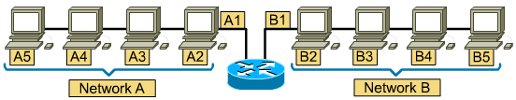
Network Addressees
The A or B to identify the network (address grouping)
The number sequence to identify the individual host
Network address and host address create a unique address for each device on the network.
Notes:
For any two systems to communicate, they must be able to identify and locate each other. While these addresses are not actual network addresses, they represent and show the concept of address grouping. This uses the A or B to identify the network and the number sequence to identify the individual host.
A computer may be connected to more than one network. In this situation, the system must be given more than one address. Each address will identify the connection of the computer to a different network. A device is not said to have an address, but that each of the connection points, or interfaces, on that device has an address to a network. This will allow other computers to locate the device on that particular network. The combination of letter (network address) and the number (host address) create a unique address for each device on the network.

Slide 21


IP Address Format
Each computer in a TCP/IP network must be given a unique identifier, or IP address.
This address, operating at Layer 3, allows one computer to locate another computer on a network.
32 bits
Notes:
Each computer in a TCP/IP network must be given a unique identifier, or IP address. This address, operating at Layer 3, allows one computer to locate another computer on a network. All computers also have a unique physical address, known as a MAC address. These are assigned by the manufacturer of the network interface card. MAC addresses operate at Layer 2 of the OSI model.
An IP address is a 32-bit sequence of 1s and 0s. Figure shows a sample 32-bit number. To make the IP address easier to use, the address is usually written as four decimal numbers separated by periods. For example, an IP address of one computer is 192.168.1.2. Another computer might have the address 128.10.2.1. This way of writing the address is called the dotted decimal format. In this notation, each IP address is written as four parts separated by periods, or dots. Each part of the address is called an octet because it is made up of eight binary digits. For example, the IP address 192.168.1.8 would be 11000000.10101000.00000001.00001000 in binary notation. The dotted decimal notation is an easier method to understand than the binary ones and zeros method. This dotted decimal notation also prevents a large number of transposition errors that would result if only the binary numbers were used.
Using dotted decimal allows number patterns to be more easily understood. Both the binary and decimal numbers in Figure represent the same values, but it is easier to see in dotted decimal notation. This is one of the common problems found in working directly with binary number. The long strings of repeated ones and zeros make transposition and omission errors more likely.
It is easy to see the relationship between the numbers 192.168.1.8 and 192.168.1.9, where 11000000.10101000.00000001.00001000 and 11000000.10101000.00000001.00001001 are not as easy to recognize. Looking at the binary, it is almost impossible to see that they are consecutive numbers.

Slide 22
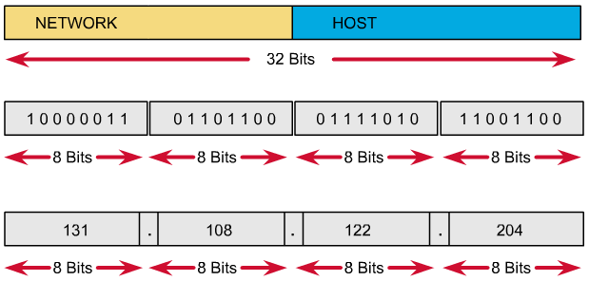
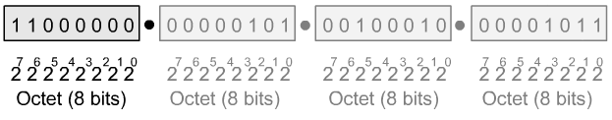
Decimal and binary conversion

Slide 23
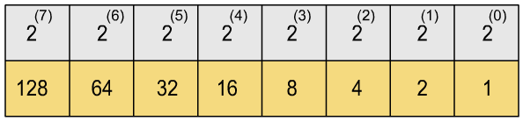
Fast conversion

Slide 24
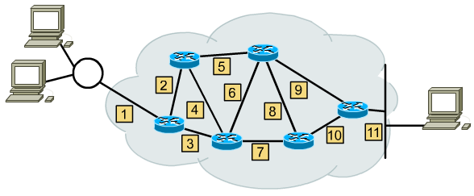
Network layer communication path
Using the IP address of destination network, a router can deliver a packet to the correct network

Slide 25
Network layer communication path
To router forwards packets, the packets must include an identifier for both the source and destination networks.
The network address helps the router identify a path within the network cloud.
The router uses the network address to identify the destination network of a packet within an internetwork.
The router uses the IP address to locate the particular computer connected to that network.
Notes:
IPv4 addressing A router forwards packets from the originating network to the destination network using the IP protocol. The packets must include an identifier for both the source and destination networks. Using the IP address of destination network, a router can deliver a packet to the correct network. When the packet arrives at a router connected to the destination network, the router uses the IP address to locate the particular computer connected to that network. This system works in much the same way as the national postal system. When the mail is routed, it must first be delivered to the post office at the destination city using the zip code. That post office then must locate the final destination in that city using the street address. This is a two-step process.

Slide 26
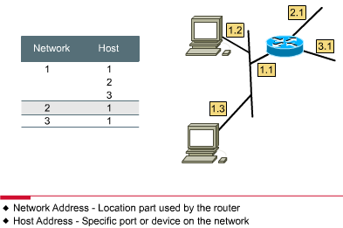
Network and host addressing
Network address + Host address:
➔ Hierarchical Addressing Schemes.
Notes:
Accordingly, every IP address has two parts. One part identifies the network where the system is connected, and a second part identifies that particular system on the network. As is shown Figure , each octet ranges from 0 to 255. Each one of the octets breaks down into 256 subgroups and they break down into another 256 subgroups with 256 addresses in each. By referring to the group address directly above a group in the hierarchy, all of the groups that branch from that address can be referenced as a single unit.

Slide 27
Internet addresses (hierarchical)
Internet addresses
1.0.0.0
2.0.0.0
3.0.0.0
---
10.0.0.0
11.0.0.0
---
255.0.0.0
10.1.0.0
10.2.0.0
10.3.0.0
---
10.255.0.0
10.2.1.0
10.2.2.0
10.2.3.0
10.2.255.0
10.255.1.0
10.255.255.0
10.2.2.1
10.2.2.2
10.2.2.254
10.255.1.1
10.255.1.200
Notes:
This kind of address is called a hierarchical address, because it contains different levels. An IP address combines these two identifiers into one number. This number must be a unique number, because duplicate addresses would make routing impossible. The first part identifies the system's network address. The second part, called the host part, identifies which particular machine it is on the network.

Slide 28
IP address classes
Class A |  | Network | Host
Octet |  | 1 | 2 | 3 | 4
Class B |  | Network |  | Host
Octet |  | 1 | 2 | 3 | 4
Class C |  | Network |  |  | Host
Octet |  | 1 | 2 | 3 | 4
To accommodate different size networks and aid in classifying these networks, IP addresses are divided into groups called classes. This is known as classful addressing.
Different class addresses reserve different amounts of bits for the Network and Host portions of the address

Slide 29
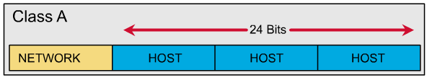
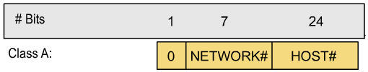
IP address classes: Class A
Notes:
The Class A address was designed to support extremely large networks, with more than 16 million host addresses available. Class A IP addresses use only the first octet to indicate the network address. The remaining three octets provide for host addresses.
The first bit of a Class A address is always 0. With that first bit a 0, the lowest number that can be represented is 00000000, decimal 0. The highest number that can be represented is 01111111, decimal 127. The numbers 0 and 127 are reserved and cannot be used as network addresses. Any address that starts with a value between 1 and 126 in the first octet is a Class A address.
The 127.0.0.0 network is reserved for loopback testing. Routers or local machines can use this address to send packets back to themselves. Therefore, this number cannot be assigned to a network.

Slide 30
IP address classes: Class A
The first bit of a Class A address is always 0.
The first 8 bits to identify the network part of the address.
Possible network address from 1.0.0.0 to 126.0.0.0
The remaining three octets can be used for the host portion of the address.
Each class A network have up to 16,777,214 possible IP addresses( 2²⁴-2)

Slide 31
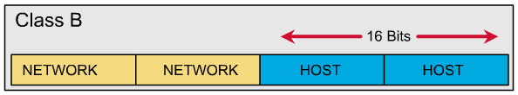

IP address classes: Class B
Notes:
The Class B address was designed to support the needs of moderate to large-sized networks. A Class B IP address uses the first two of the four octets to indicate the network address. The other two octets specify host addresses.
The first two bits of the first octet of a Class B address are always 10. The remaining six bits may be populated with either 1s or 0s. Therefore, the lowest number that can be represented with a Class B address is 10000000, decimal 128. The highest number that can be represented is 10111111, decimal 191. Any address that starts with a value in the range of 128 to 191 in the first octet is a Class B address.

Slide 32
IP address classes: Class B
The first 2 bits of a Class B address is always 10.
The first two octets to identify the network part of the address.
Possible network address from 128.0.0.0 to 191.255.0.0 (2 ¹⁴)
The remaining two octets can be used for the host portion of the address.
Class B network have up to 65.534 possible IP addresses (2 ¹⁶ -2)

Slide 33
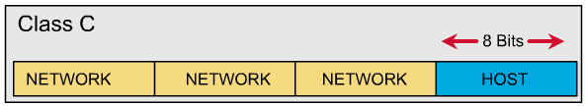
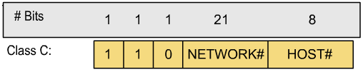
IP address classes: Class C
Notes:
The Class C address space is the most commonly used of the original address classes. This address space was intended to support small networks with a maximum of 254 hosts.
A Class C address begins with binary 110. Therefore, the lowest number that can be represented is 11000000, decimal 192. The highest number that can be represented is 11011111, decimal 223. If an address contains a number in the range of 192 to 223 in the first octet, it is a Class C address.

Slide 34
IP address classes: Class C
The first 3 bits of a Class C address is always 110.
The first three octets to identify the network part of the address.
Possible network address from 192.0.0.0 to 223.255.255.0.
The remaining last octet can be used for the host portion of the address.
Class C network have up to 254 possible IP addresses (2 ⁸ -2) .

Slide 35
IP address classes: Summary
1.0.0.0 - 126.0.0.0 : Class A.
127.0.0.0 : Loopback network.
128.0.0.0 - 191.255.0.0 : Class B.
192.0.0.0 - 223.255.255.0 : Class C.
224.0.0.0 < 240.0.0.0 : Class D, multicast.
>= 240.0.0.0 : Class E, reserved.
Notes:
The Class D address class was created to enable multicasting in an IP address. A multicast address is a unique network address that directs packets with that destination address to predefined groups of IP addresses. Therefore, a single station can simultaneously transmit a single stream of data to multiple recipients.
The Class D address space, much like the other address spaces, is mathematically constrained. The first four bits of a Class D address must be 1110. Therefore, the first octet range for Class D addresses is 11100000 to 11101111, or 224 to 239. An IP address that starts with a value in the range of 224 to 239 in the first octet is a Class D address.
A Class E address has been defined. However, the Internet Engineering Task Force (IETF) reserves these addresses for its own research. Therefore, no Class E addresses have been released for use in the Internet. The first four bits of a Class E address are always set to 1s. Therefore, the first octet range for Class E addresses is 11110000 to 11111111, or 240 to 255.

Slide 36
Reserved IP addresses
Network address– Used to identify the network itself
  An IP address that has binary 0s in all host bit positions
Broadcast address – Used for broadcasting packets to all the devices on a network.
  An IP addresses end with binary 1s in the entire host part of the address.
Notes:
Reserved IP addresses Certain host addresses are reserved and cannot be assigned to devices on a network. These reserved host addresses include the following:
Network address – Used to identify the network itself
In Figure , the section that is identified by the upper box represents the 198.150.11.0 network. Data that is sent to any host on that network (198.150.11.1- 198.150.11.254) will be seen outside of the local area network as 198.159.11.0. The only time that the host numbers matter is when the data is on the local area network. The LAN that is contained in the lower box is treated the same as the upper LAN, except that its network number is 198.150.12.0.
Broadcast address – Used for broadcasting packets to all the devices on a network
In Figure , the section that is identified by the upper box represents the 198.150.11.255 broadcast address. Data that is sent to the broadcast address will be read by all hosts on that network (198.150.11.1- 198.150.11.254). The LAN that is contained in the lower box is treated the same as the upper LAN, except that its broadcast address is 198.150.12.255.
An IP address that has binary 0s in all host bit positions is reserved for the network address. In a Class A network example, 113.0.0.0 is the IP address of the network, known as the network ID, containing the host 113.1.2.3. A router uses the network IP address when it forwards data on the Internet. In a Class B network example, the address 176.10.0.0 is a network address, as shown in Figure .
In a Class B network address, the first two octets are designated as the network portion. The last two octets contain 0s because those 16 bits are for host numbers and are used to identify devices that are attached to the network. The IP address, 176.10.0.0, is an example of a network address. This address is never assigned as a host address. A host address for a device on the 176.10.0.0 network might be 176.10.16.1. In this example, “176.10” is the network portion and “16.1” is the host portion.
To send data to all the devices on a network, a broadcast address is needed. A broadcast occurs when a source sends data to all devices on a network. To ensure that all the other devices on the network process the broadcast, the sender must use a destination IP address that they can recognize and process. Broadcast IP addresses end with binary 1s in the entire host part of the address.
In the network example, 176.10.0.0, the last 16 bits make up the host field or host part of the address. The broadcast that would be sent out to all devices on that network would include a destination address of 176.10.255.255. This is because 255 is the decimal value of an octet containing 11111111.

Slide 37
Public IP addresses
The stability of the Internet depends directly on the uniqueness of publicly used network addresses.
Unique addresses are required for each device on a network. To make that an organization known as the Internet Network Information Center (InterNIC) handled this procedure. Now replate by the Intreernet Assigned Numbers Authority (IANA).
Public IP addresses must be obtained from an Internet service provider (ISP) or a registry at some expense
Notes:
The stability of the Internet depends directly on the uniqueness of publicly used network addresses. In Figure , there is an issue with the network addressing scheme. In looking at the networks, both have a network address of 198.150.11.0. The router in this illustration will not be able to forward the data packets correctly. Duplicate network IP addresses prevent the router from performing its job of best path selection. Unique addresses are required for each device on a network.
A procedure was needed to make sure that addresses were in fact unique. Originally, an organization known as the Internet Network Information Center (InterNIC) handled this procedure. InterNIC no longer exists and has been succeeded by the Internet Assigned Numbers Authority (IANA). IANA carefully manages the remaining supply of IP addresses to ensure that duplication of publicly used addresses does not occur. Duplication would cause instability in the Internet and compromise its ability to deliver datagrams to networks.
Public IP addresses are unique. No two machines that connect to a public network can have the same IP address because public IP addresses are global and standardized. All machines connected to the Internet agree to conform to the system. Public IP addresses must be obtained from an Internet service provider (ISP) or a registry at some expense

Slide 38
Private IP addresses
According to RFC-1918.
Organizations make use of the private Internet address space for hosts that require IP connectivity within their enterprise network, but do not require external connections to the global Internet.
Class A: 10.0.0.0.
Class B: 172.16.0.0 - 172.31.0.0.
Class C: 192.168.0.0 - 192.168.255.0.
Notes:
With the rapid growth of the Internet, public IP addresses were beginning to run out. New addressing schemes, such as classless interdomain routing (CIDR) and IPv6 were developed to help solve the problem. CIDR and IPv6 are discussed later in the course.
Private IP addresses are another solution to the problem of the impending exhaustion of public IP addresses. As mentioned, public networks require hosts to have unique IP addresses. However, private networks that are not connected to the Internet may use any host addresses, as long as each host within the private network is unique. Many private networks exist alongside public networks. However, a private network using just any address is strongly discouraged because that network might eventually be connected to the Internet. RFC 1918 sets aside three blocks of IP addresses for private, internal use. These three blocks consist of one Class A, a range of Class B addresses, and a range of Class C addresses. Addresses that fall within these ranges are not routed on the Internet backbone. Internet routers immediately discard private addresses. If addressing a nonpublic intranet, a test lab, or a home network, these private addresses can be used instead of globally unique addresses. Private IP addresses can be intermixed, as shown in the graphic, with public IP addresses. This will conserve the number of addresses used for internal connections.
Connecting a network using private addresses to the Internet requires translation of the private addresses to public addresses. This translation process is referred to as Network Address Translation (NAT). A router usually is the device that performs NAT. NAT, along with CIDR and IPv6 are covered in more depth later in the curriculum.

Slide 39
Introduction to subnetting
Why we need to divide network?
Network administrators sometimes need to divide networks, especially large ones, into smaller networks:
  Reduce the size of a broadcast domain, optimized network performance.
  Improve network security.
  Simplified management.
  Facilitated spanning of large geographical distances.
So we need more network addresses for your network. But I want the outside networks see our network as a single network.
Notes:
Subnetting is another method of managing IP addresses. This method of dividing full network address classes into smaller pieces has prevented complete IP address exhaustion. It is impossible to cover TCP/IP without mentioning subnetting. As a system administrator it is important to understand subnetting as a means of dividing and identifying separate networks throughout the LAN. It is not always necessary to subnet a small network. However, for large or extremely large networks, subnetting is required. Subnetting a network means to use the subnet mask to divide the network and break a large network up into smaller, more efficient and manageable segments, or subnets. An example would be the U.S. telephone system which is broken into area codes, exchange codes, and local numbers.
The system administrator must resolve these issues when adding and expanding the network. It is important to know how many subnets or networks are needed and how many hosts will be needed on each network. With subnetting, the network is not limited to the default Class A, B, or C network masks and there is more flexibility in the network design.

Slide 40
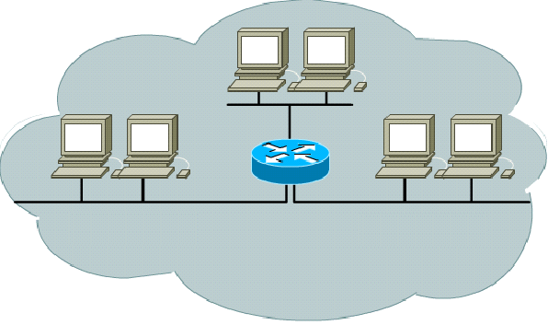
Without subnet
131.3.0.0
131.1.0.0
131.2.0.0
The smallest group is a single, entire Class A, B, or C network number.
The NIC would be woefully short of assignable networks.

Slide 41
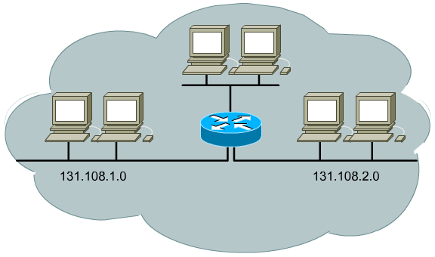
Divide network by three
The NIC can assign one or a few network numbers to an organization, and then the organization can subdivide those networks into subnets of more usable sizes.

Slide 42

Subnetting
Subnetworks are smaller divisions of network.
Subnet addresses include the Class A, Class B, or Class C network portion, plus a subnet field and a host field.
To create a subnet address, a network administrator borrows bits from the original host portion and designates them as the subnet field.
Subnet addresses are assigned locally, usually by a network administrator.
Notes:
Subnet addresses include the network portion, plus a subnet field and a host field. The subnet field and the host field are created from the original host portion for the entire network. The ability to decide how to divide the original host portion into the new subnet and host fields provides addressing flexibility for the network administrator.
To create a subnet address, a network administrator borrows bits from the host field and designates them as the subnet field. The minimum number of bits that can be borrowed is two. When creating a subnet, where only one bit was borrowed the network number would be the .0 network. The broadcast number would then be the .255 network. The maximum number of bits that can be borrowed can be any number that leaves at least two bits remaining, for the host number.

Slide 43
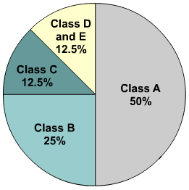
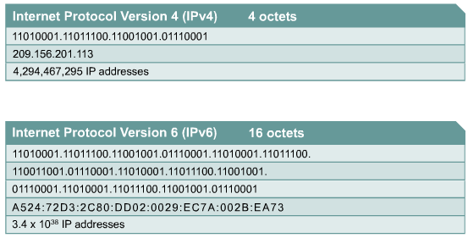
IPv4 versus IPv6
Notes:
When TCP/IP was adopted in the 1980s, it relied on a two-level addressing scheme. At the time this offered adequate scalability. Unfortunately, the designers of TCP/IP could not have predicted that their protocol would eventually sustain a global network of information, commerce, and entertainment. Over twenty years ago, IP Version 4 (IPv4) offered an addressing strategy that, although scalable for a time, resulted in an inefficient allocation of addresses. The Class A and B addresses make up 75 percent of the IPv4 address space, however fewer than 17,000 organizations can be assigned a Class A or B network number. Class C network addresses are far more numerous than Class A and Class B addresses, although they account for only 12.5 percent of the possible four billion IP addresses.
Unfortunately, Class C addresses are limited to 254 usable hosts. This does not meet the needs of larger organizations that cannot acquire a Class A or B address. Even if there were more Class A, B, and C addresses, too many network addresses would cause Internet routers to come to a stop under the burden of the enormous size of routing tables required to store the routes to reach each of the networks.
As early as 1992, the Internet Engineering Task Force (IETF) identified the following two specific concerns:
Exhaustion of the remaining, unassigned IPv4 network addresses. At the time, the Class B space was on the verge of depletion.
The rapid and large increase in the size of Internet routing tables occurred as more Class C networks came online. The resulting flood of new network information threatened the ability of Internet routers to cope effectively.
Over the past two decades, numerous extensions to IPv4 have been developed. These extensions are specifically designed to improve the efficiency with which the 32-bit address space can be used. Two of the more important of these are subnet masks and classless interdomain routing (CIDR), which are discussed in more detail in later lessons.
Meanwhile, an even more extendible and scalable version of IP, IP Version 6 (IPv6), has been defined and developed. IPv6 uses 128 bits rather than the 32 bits currently used in IPv4. IPv6 uses hexadecimal numbers to represent the 128 bits. IPv6 provides 640 sextrillion addresses. This version of IP should provide enough addresses for future communication needs. Figure shows IPv4 addresses which are 32 bits long, written in decimal form, and separated by periods. IPv6 addresses are 128 bits long, written in hexadecimal form, and separated by colons. IPv6 fields are 16 bits long. To make the addresses easier to read, leading zeros can be omitted from each field. The field :0003: is written :3:. IPv6 shorthand representation of the 128 bits uses eight 16-bit numbers, shown as four hexadecimal digits.
After years of planning and development, IPv6 is slowly being implemented in select networks. Eventually, IPv6 may replace IPv4 as the dominant Internet protocol.

Slide 44

OBTAINING AN IP ADDRESS

Slide 45
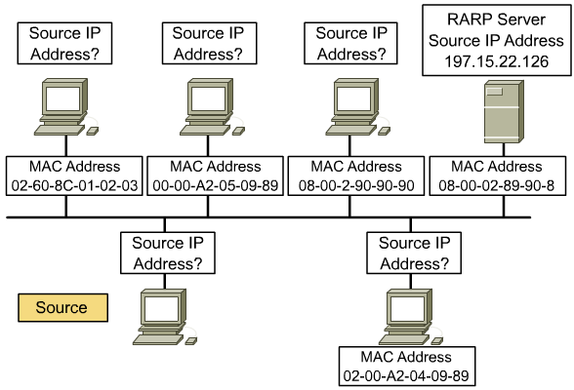
IP address assignment
static addressing and dynamic addressing

Slide 46
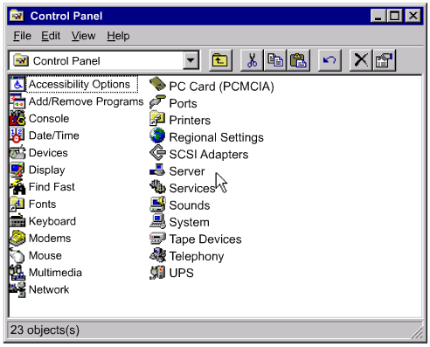
Static addressing

Slide 47
Dynamic addressing
There are a few different methods that you can use to assign IP addresses dynamically:
RARP: Reverse Address Resolution Protocol.
BOOTP: BOOTstrap Protocol.
DHCP: Dynamic Host Configuration Protocol.

Slide 48
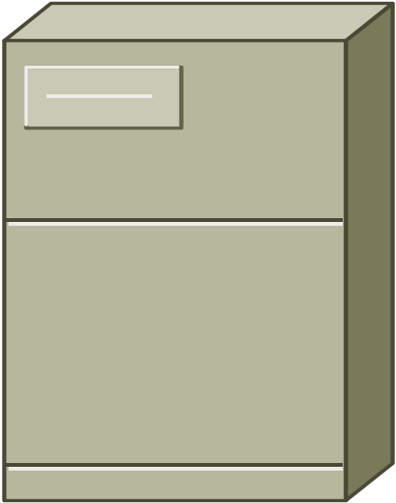
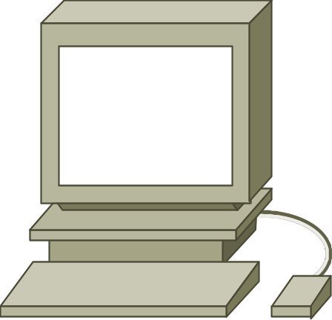
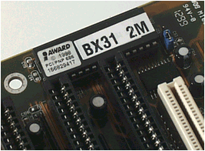
Dynamic addressing: RARP
RARP Request
RARP Reply
MAC: Known
IP: Unknown
RARP server
Notes:
RARP IP address assignment Reverse Address Resolution Protocol (RARP) associates a known MAC addresses with an IP addresses. This association allows network devices to encapsulate data before sending the data out on the network. A network device, such as a diskless workstation, might know its MAC address but not its IP address. RARP allows the device to make a request to learn its IP address. Devices using RARP require that a RARP server be present on the network to answer RARP requests. Consider an example where a source device wants to send data to another device. In this example, the source device knows its own MAC address but is unable to locate its own IP address in the ARP table. The source device must include both its MAC address and IP address in order for the destination device to retrieve data, pass it to higher layers of the OSI model, and respond to the originating device. Therefore, the source initiates a process called a RARP request. This request helps the source device detect its own IP address. RARP requests are broadcast onto the LAN and are responded to by the RARP server which is usually a router. RARP uses the same packet format as ARP. However, in a RARP request, the MAC headers and "operation code" are different from an ARP request. The RARP packet format contains places for MAC addresses of both the destination and source devices. The source IP address field is empty. The broadcast goes to all devices on the network. Therefore, the destination MAC address will be set to all binary 1s. Workstations running RARP have codes in ROM that direct them to start the RARP process. A step-by-step layout of the RARP process is illustrated in Figures through .

Slide 49
Dynamic addressing: RARP
Reverse address resolution protocol (RARP) binds MAC addresses to IP addresses.
A network device might know its MAC address but not its IP address in diskless workstations or dumb terminals. Devices using RARP require that a RARP server
A RARP request consists of a MAC header, an IP header, and an ARP request message.
Workstations running RARP have codes in ROM that direct them to start the RARP process, and locate the RARP server.

Slide 50
ARP and RARP message structure
Hardware type
Protocol Type
1: ARP request
2: ARP reply
3. RARP request
4. RARP reply
Hardware
Length
Protocol
Length
Operation
Sender hardware address
Sender protocol address
HTYPE: 16 bit
PTYPE: 16 bit
HLEN: 8 bit
PLEN: 8 bit
OPER: 16 bit
SHA: variable len
SPA: variable len
THA: variable len
TPA: variable len
Target hardware address
Target protocol address

Slide 51
Dynamic addressing: BOOTP
UDP Broadcast
UDP Broadcast
MAC: Known
IP: Unknown
BOOTP server
IP Address
Gateway
IP of server
Filename of boot file
MAC1 – IP1
MAC2 – IP2
MAC3 – IP3
Notes:
The bootstrap protocol (BOOTP) operates in a client-server environment and only requires a single packet exchange to obtain IP information. However, unlike RARP, BOOTP packets can include the IP address, as well as the address of a router, the address of a server, and vendor-specific information.
One problem with BOOTP, however, is that it was not designed to provide dynamic address assignment. With BOOTP, a network administrator creates a configuration file that specifies the parameters for each device. The administrator must add hosts and maintain the BOOTP database. Even though the addresses are dynamically assigned, there is still a one to one relationship between the number of IP addresses and the number of hosts. This means that for every host on the network there must be a BOOTP profile with an IP address assignment in it. No two profiles can have the same IP address. Those profiles might be used at the same time and that would mean that two hosts have the same IP address.

Slide 52
Dynamic addressing: BOOTP
A device uses BOOTstrap protocol (BOOTP) when it starts up, to obtain an IP address. BOOTP uses UDP to carry messages; the UDP message is encapsulated in an IP datagram.
A computers uses BOOTP to send a broadcast IP datagram (using a destination IP address of all 1s - 255.255.255.255), a BOOTP server receives the broadcast and then sends a broadcast.
The client receives a datagram and checks the MAC address, if it finds its own MAC address in the destination address field, it then takes the IP address in that datagram.
Notes:
A device uses BOOTP to obtain an IP address when starting up. BOOTP uses UDP to carry messages. The UDP message is encapsulated in an IP packet. A computer uses BOOTP to send a broadcast IP packet using a destination IP address of all 1s, 255.255.255.255 in dotted decimal notation. A BOOTP server receives the broadcast and then sends back a broadcast. The client receives a frame and checks the MAC address. If the client finds its own MAC address in the destination address field and a broadcast in the IP destination field, it takes and stores the IP address and other information supplied in the BOOTP reply message. A step-by-step description of the process is shown in Figures through .

Slide 53
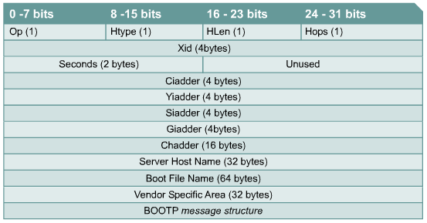
BooTP message structure

Slide 54
Dynamic addressing: DHCP
Dynamic host configuration protocol (DHCP) has been proposed as a successor to BOOTP. Unlike BOOTP, DHCP allows a host to obtain an IP address quickly and dynamically.
All that is required using DHCP is a defined range of IP addresses on a DHCP server (commonly referred to as a scope).
As hosts come online they contact the DHCP server and request an address. The DHCP server chooses an address and allocates it to that host
Notes:
Dynamic host configuration protocol (DHCP) is the successor to BOOTP. Unlike BOOTP, DHCP allows a host to obtain an IP address dynamically without the network administrator having to set up an individual profile for each device. All that is required when using DHCP is a defined range of IP addresses on a DHCP server. As hosts come online, they contact the DHCP server and request an address. The DHCP server chooses an address and leases it to that host. With DHCP, the entire network configuration of a computer can be obtained in one message. This includes all of the data supplied by the BOOTP message, plus a leased IP address and a subnet mask.
The major advantage that DHCP has over BOOTP is that it allows users to be mobile. This mobility allows the users to freely change network connections from location to location. It is no longer required to keep a fixed profile for every device attached to the network as was required with the BOOTP system. The importance to this DHCP advancement is its ability to lease an IP address to a device and then reclaim that IP address for another user after the first user releases it. This means that DHCP offers a one to many ratio of IP addresses and that an address is available to anyone who connects to the network.

Slide 55
Dynamic addressing: DHCP
DHCP Discover
UDP Broadcast
DHCP Offer
UDP Broadcast
DHCP Request
IP Address
Lease time
DHCP sever IP Address
DHCP Ack
DHCP server
MAC: Known
IP: Unknown
Gateway
IP of other servers
And more …
IP1
IP2
IP3

Slide 56
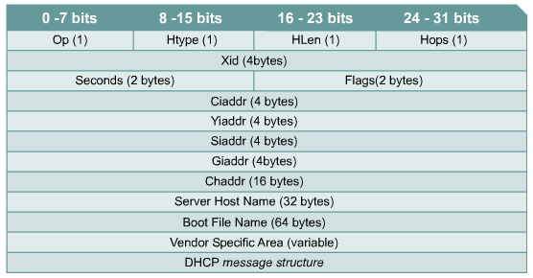
DHCP message structure

Slide 57
Address Resolution Protocol (ARP)
In order for devices to communicate, the sending devices need both the IP addresses and the MAC addresses of the destination devices.
When they try to communicate with devices whose IP addresses they know, they must determine the MAC addresses.
ARP enables a computer to find the MAC address of the computer that is associated with an IP address.
Notes:
Address Resolution Protocol (ARP) With TCP/IP networking, a data packet must contain both a destination MAC address and a destination IP address. If the packet is missing either one, the data will not pass from Layer 3 to the upper layers. In this way, MAC addresses and IP addresses act as checks and balances for each other. After devices determine the IP addresses of the destination devices, they can add the destination MAC addresses to the data packets.

Slide 58
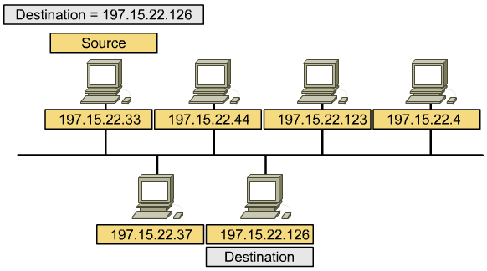
Address resolution protocol

Slide 59
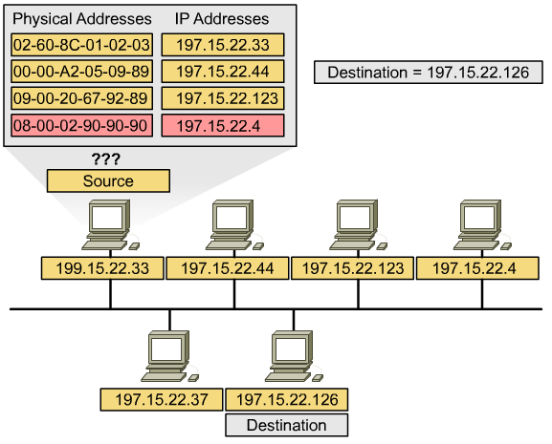
ARP table in host
RAM
Notes:
Some devices will keep tables that contain MAC addresses and IP addresses of other devices that are connected to the same LAN. These are called Address Resolution Protocol (ARP) tables. ARP tables are stored in RAM memory, where the cached information is maintained automatically on each of the devices. It is very unusual for a user to have to make an ARP table entry manually. Each device on a network maintains its own ARP table. When a network device wants to send data across the network, it uses information provided by the ARP table.

Slide 60

ARP operation
ARP Table:
?
MAC
A.B.C.1.2.3
MAC
?
IP
197.15.22.33
IP
197.15.22.35
Data
197.15.22.33
197.15.22.34
197.15.22.35
A.B.C.1.3.3
A.B.C.4.3.4
A.B.C.7.3.5
A
B
C
Notes:
When a source determines the IP address for a destination, it then consults the ARP table in order to locate the MAC address for the destination. If the source locates an entry in its table, destination IP address to destination MAC address, it will associate the IP address to the MAC address and then uses it to encapsulate the data. The data packet is then sent out over the networking media to be picked up by the destination device.
There are two ways that devices can gather MAC addresses that they need to add to the encapsulated data. One way is to monitor the traffic that occurs on the local network segment. All stations on an Ethernet network will analyze all traffic to determine if the data is for them. Part of this process is to record the source IP and MAC address of the datagram to an ARP table. So as data is transmitted on the network, the address pairs populate the ARP table. Another way to get an address pair for data transmission is to broadcast an ARP request.
The computer that requires an IP and MAC address pair broadcasts an ARP request. All the other devices on the local area network analyze this request. If one of the local devices matches the IP address of the request, it sends back an ARP reply that contains its IP-MAC pair. If the IP address is for the local area network and the computer does not exist or is turned off, there is no response to the ARP request. In this situation, the source device reports an error. If the request is for a different IP network, there is another process that can be used.

Slide 61
ARP operation: ARP request
MAC
A.B.C.1.3.3
MAC
ff.ff.ff.ff.ff.ff
IP
197.15.22.33
IP
197.15.22.35
What is your MAC Addr?
197.15.22.33
197.15.22.34
197.15.22.35
A.B.C.1.3.3
A.B.C.4.3.4
A.B.C.7.3.5
A
B
C

Slide 62
ARP operation: Checking
MAC
A.B.C.1.3.3
MAC
ff.ff.ff.ff.ff.ff
IP
197.15.22.33
IP
197.15.22.35
What is your MAC Addr?
That is
my IP
197.15.22.33
197.15.22.34
197.15.22.35
A.B.C.1.3.3
A.B.C.4.3.4
A.B.C.7.3.5
A
B
C

Slide 63
ARP operation: ARP reply
MAC
A.B.C.7.3.5
MAC
A.B.C.1.3.3
IP
197.15.22.35
IP
197.15.22.33
This is my MAC Addr
10.0.2.1
10.0.2.5
10.0.2.9
A.B.C.1.3.3
A.B.C.4.3.4
A.B.C.7.3.5
A
B
C

Slide 64
ARP operation: Caching
ARP Table:
A.B.C.7.3.5 – 197.15.22.35
MAC
A.B.C.1.3.3
MAC
A.B.C.7.3.5
IP
197.15.22.33
IP
197.15.22.35
Data
197.15.22.33
197.15.22.34
197.15.22.35
A.B.C.1.3.3
A.B.C.4.3.4
A.B.C.7.3.5
A
B
C

Slide 65
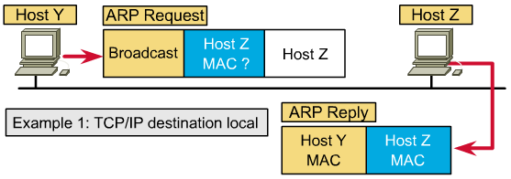
ARP: Destination local

Slide 66
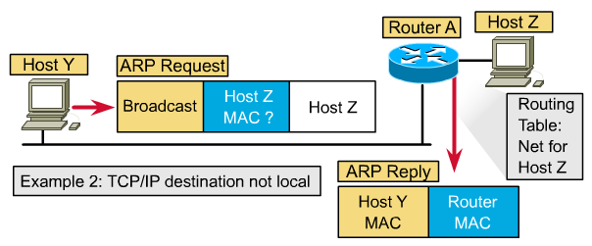
ARP: Destination not local
Notes:
Routers do not forward broadcast packets. If the feature is turned on, a router performs a proxy ARP. Proxy ARP is a variation of the ARP protocol. In this variation, a router sends an ARP response with the MAC address of the interface on which the request was received, to the requesting host. The router responds with the MAC addresses for those requests in which the IP address is not in the range of addresses of the local subnet.
Another method to send data to the address of a device that is on another network segment is to set up a default gateway. The default gateway is a host option where the IP address of the router interface is stored in the network configuration of the host. The source host compares the destination IP address and its own IP address to determine if the two IP addresses are located on the same segment. If the receiving host is not on the same segment, the source host sends the data using the actual IP address of the destination and the MAC address of the router. The MAC address for the router was learned from the ARP table by using the IP address of that router.
If the default gateway on the host or the proxy ARP feature on the router is not configured, no traffic can leave the local area network. One or the other is required to have a connection outside of the local area network.

Slide 67
Default gateway
In order for a device to communicate with another device on another network, you must supply it with a default gateway.
A default gateway is the IP address of the interface on the router that connects to the network segment on which the source host is located.
In order for a device to send data to the address of a device that is on another network segment, the source device sends the data to a default gateway.

Slide 68
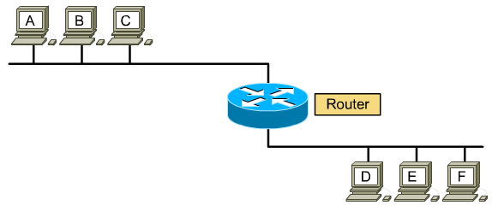
Proxy ARP
ARP Reply
TCP/IP has a variation on ARP called Proxy ARP that will provide the MAC address of an intermediate device for transmission outside the LAN to another network segment.

Slide 69
ARP Flowchart
Send Data
to a device
Is the
MAC address
in my ARP
cache
N
Send an
ARP request
Y
Get an
ARP reply
Send Data

Slide 70
Flowchart: Exercises
Create flowcharts for the following processes:
  RARP
  BOOTP
  DHCP
  Proxy ARP (in router)

Slide 71
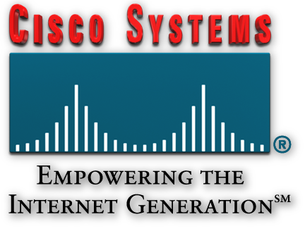
Summary
Why the Internet was developed and how TCP/IP fits the design of the Internet
The four layers of the TCP/IP model
The functions of each layer of the TCP/IP model
The OSI model compared to the TCP/IP model
IP addressing gives each device on the Internet a unique identifier
IP address classes are logical divisions of the address space used to meet the needs of various sizes of networks
Subnetting is used to divide a network into smaller networks
Reserved addresses fulfill a special role in IP addressing and cannot be used for any other purpose
Private addresses cannot be routed on the public Internet.

Slide 72
Summary
The function of a subnet mask is to map the parts of an IP address that are the network and the host
Someday IPV4 will be completely obsolete and IPV6 will be the commonly used version
A computer must have an IP address to communicate on the Internet
An IP address may be configured statically or dynamically
A dynamic IP address may be allocated using RARP, BOOTP or DHCP
DHCP supplies more information to a client than BOOTP
DHCP allows computers to be mobile allowing a connection to many different networks
ARP and Proxy ARP can be used to solve address resolution problems

Slide 73

Q&A
Notes:
_________________________________________________________________________
_________________________________________________________________________
_________________________________________________________________________
_________________________________________________________________________
_________________________________________________________________________
_________________________________________________________________________
_________________________________________________________________________
_________________________________________________________________________
_________________________________________________________________________
_________________________________________________________________________
_________________________________________________________________________
_________________________________________________________________________
_________________________________________________________________________
_________________________________________________________________________
_________________________________________________________________________
_________________________________________________________________________
_________________________________________________________________________
_________________________________________________________________________
_________________________________________________________________________

Slide 74
Enjoy the Course
Notes:
_________________________________________________________________________
_________________________________________________________________________
_________________________________________________________________________
_________________________________________________________________________
_________________________________________________________________________
_________________________________________________________________________
_________________________________________________________________________
_________________________________________________________________________
_________________________________________________________________________
_________________________________________________________________________
_________________________________________________________________________
_________________________________________________________________________
_________________________________________________________________________
_________________________________________________________________________
_________________________________________________________________________
_________________________________________________________________________
_________________________________________________________________________
_________________________________________________________________________
_________________________________________________________________________

